Slide 1

UE22CS320B – Capstone Project Phase – 2
SEMESTER - VI
END SEMESTER ASSESSMENT
Project Title : Efficient AI-driven Edge Surveillance using Edge Computing
Project ID : PW25_DS_01
Project Guide : Prof. Dinesh Singh
Project Team : Herman Singh Umrao (PES1UG22AM067)
Govind Subramanian (PES1UG22CS222)
Akshaj B Seerpu (PES1UG22AM018)
Uday V (PES1UG22CS662)
Herman_Govind_Akshaj_Uday

Slide 2
Efficient AI-Driven Edge Surveillance using Edge Computing
Outline
Abstract and scope.
Suggestions from phase-2 review 2
Enhanced Literature Survey(if any)
Design Approach.
Design constraints, Assumptions and Dependencies
Architecture
Proposed methodology/Approach
Datasets exploration and Preprocessing
Base Model Implementation
Project Progress Plan for Phase 3 and Phase 4
References
Any other Information

Slide 3
Efficient AI-Driven Edge Surveillance using Edge Computing
Abstract and Scope
Abstract This project presents an efficient edge-AI based CCTV surveillance system designed for medium-footfall institutional facilities. The system leverages existing CCTV infrastructure combined with edge computing devices to perform real-time video analytics without requiring significant cloud resources.
Processing data at edge helps reduce latency for AI based detection, at the same time helping with security and also lowering required bandwidth. Our proposal will use very lightweight computer vision algorithms optimized for deployment on the edge to perform some of the monitoring tasks such as people detection, occupancy tracking, and anomaly detection.
Our proposed architecture allows facilities to upgrade their conventional CCTV systems with the capability for AI, while minimizing infrastructure cost while maintaining data privacy. Key features in the proposal include real time monitoring, local data processing, customizable alerts, and basic analytics reporting.
This system is designed for facilities that have 50 to 500 people coming daily, making it perfect for smaller and medium-sized institutions that want a less expensive, uncomplicated security system without the complexity of cloud-based or server based solutions.

Slide 4
Efficient AI-Driven Edge Surveillance using Edge Computing
Abstract and Scope
Problem Statement
Small companies/businesses cannot afford to have a server/cloud platform to perform analytics.
Tracing actions of a person within the facility premises, requires the user to watch multiple footages from different cameras.
Scope:
This project focuses on developing an AI-driven edge surveillance system that enhances real-time monitoring while minimizing infrastructure costs and privacy risks. Its key principles include:
Real-Time AI Video Analytics – Lightweight models for people detection, occupancy tracking, and anomaly detection with customizable alerts.
Edge Computing – Local processing on low-power AI devices to reduce cloud dependency and latency.
Optimized Resource Utilization – Use of efficient AI models (YOLO, FaceNet) to run on limited hardware.
Scalability & Deployment – Designed for medium-scale institutions (50-500 visitors/day) with easy integration into existing CCTV setups.
Privacy & Security – Local data storage ensures compliance with privacy regulations and prevents unauthorized data access.

Slide 5
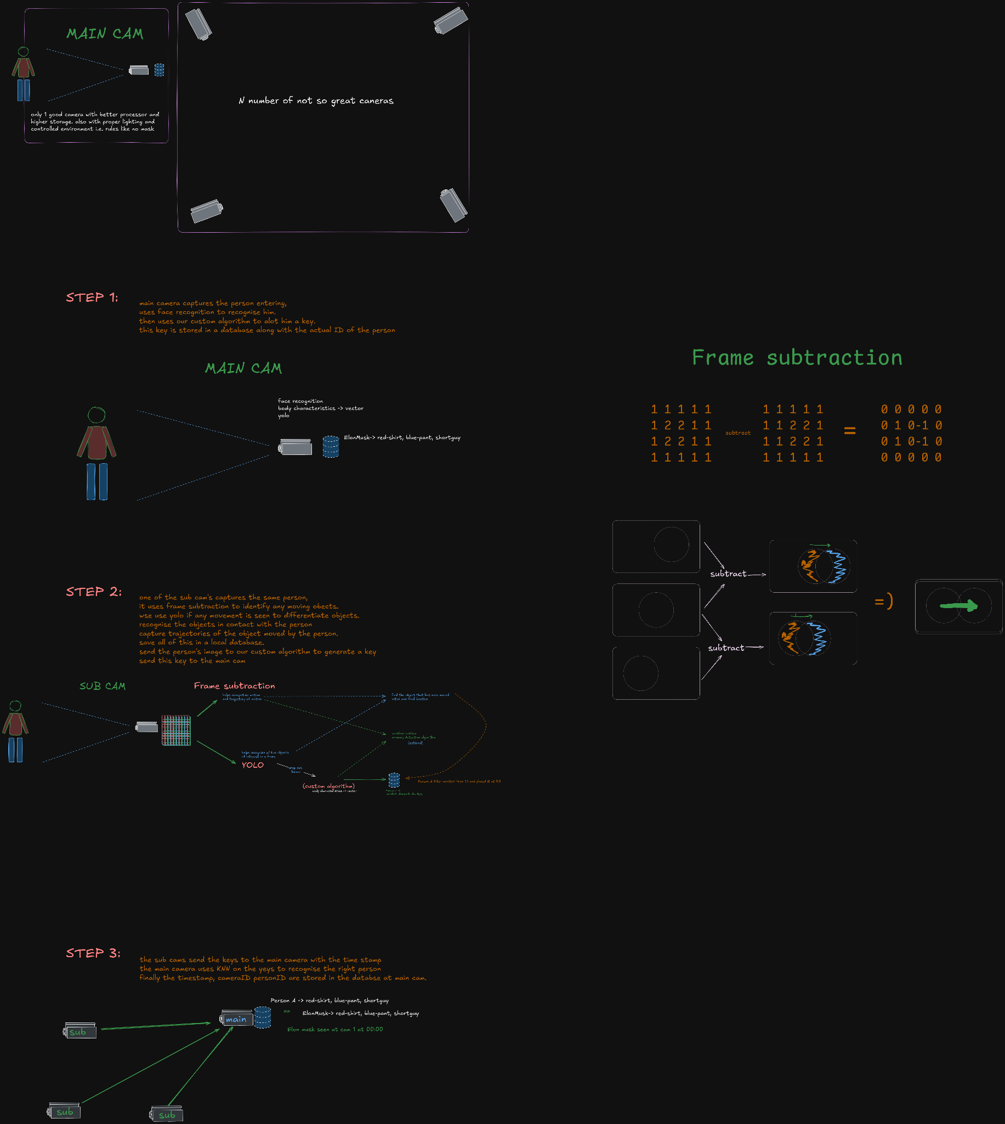
Efficient AI-Driven Edge Surveillance using Edge Computing
Design Approach

Slide 6
Efficient AI-Driven Edge Surveillance using Edge Computing
Design Approach

Slide 7
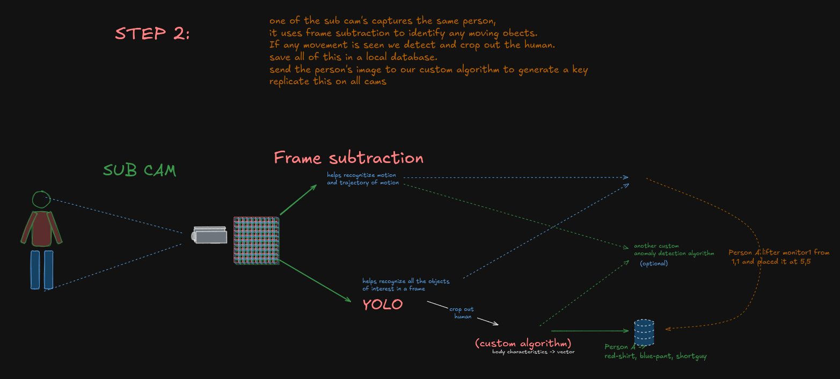
Efficient AI-Driven Edge Surveillance using Edge Computing
Design Approach

Slide 8
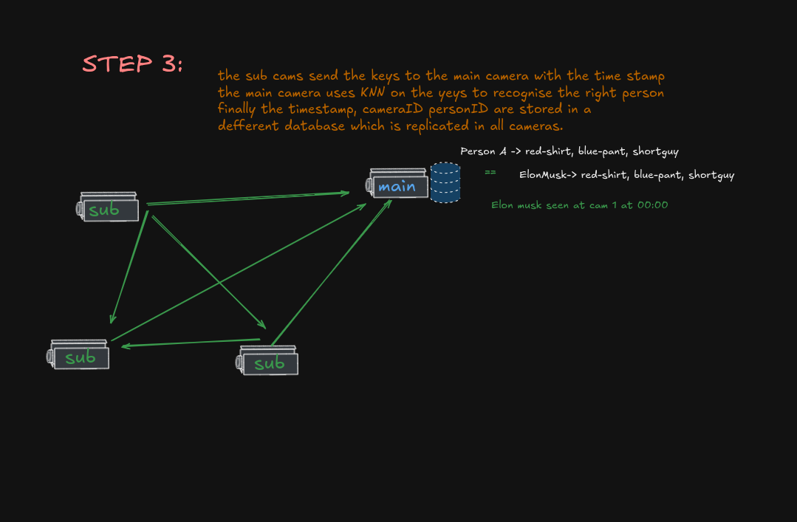
Efficient AI-Driven Edge Surveillance using Edge Computing
Design Approach

Slide 9
Efficient AI-Driven Edge Surveillance using Edge Computing
Design Approach

Slide 10
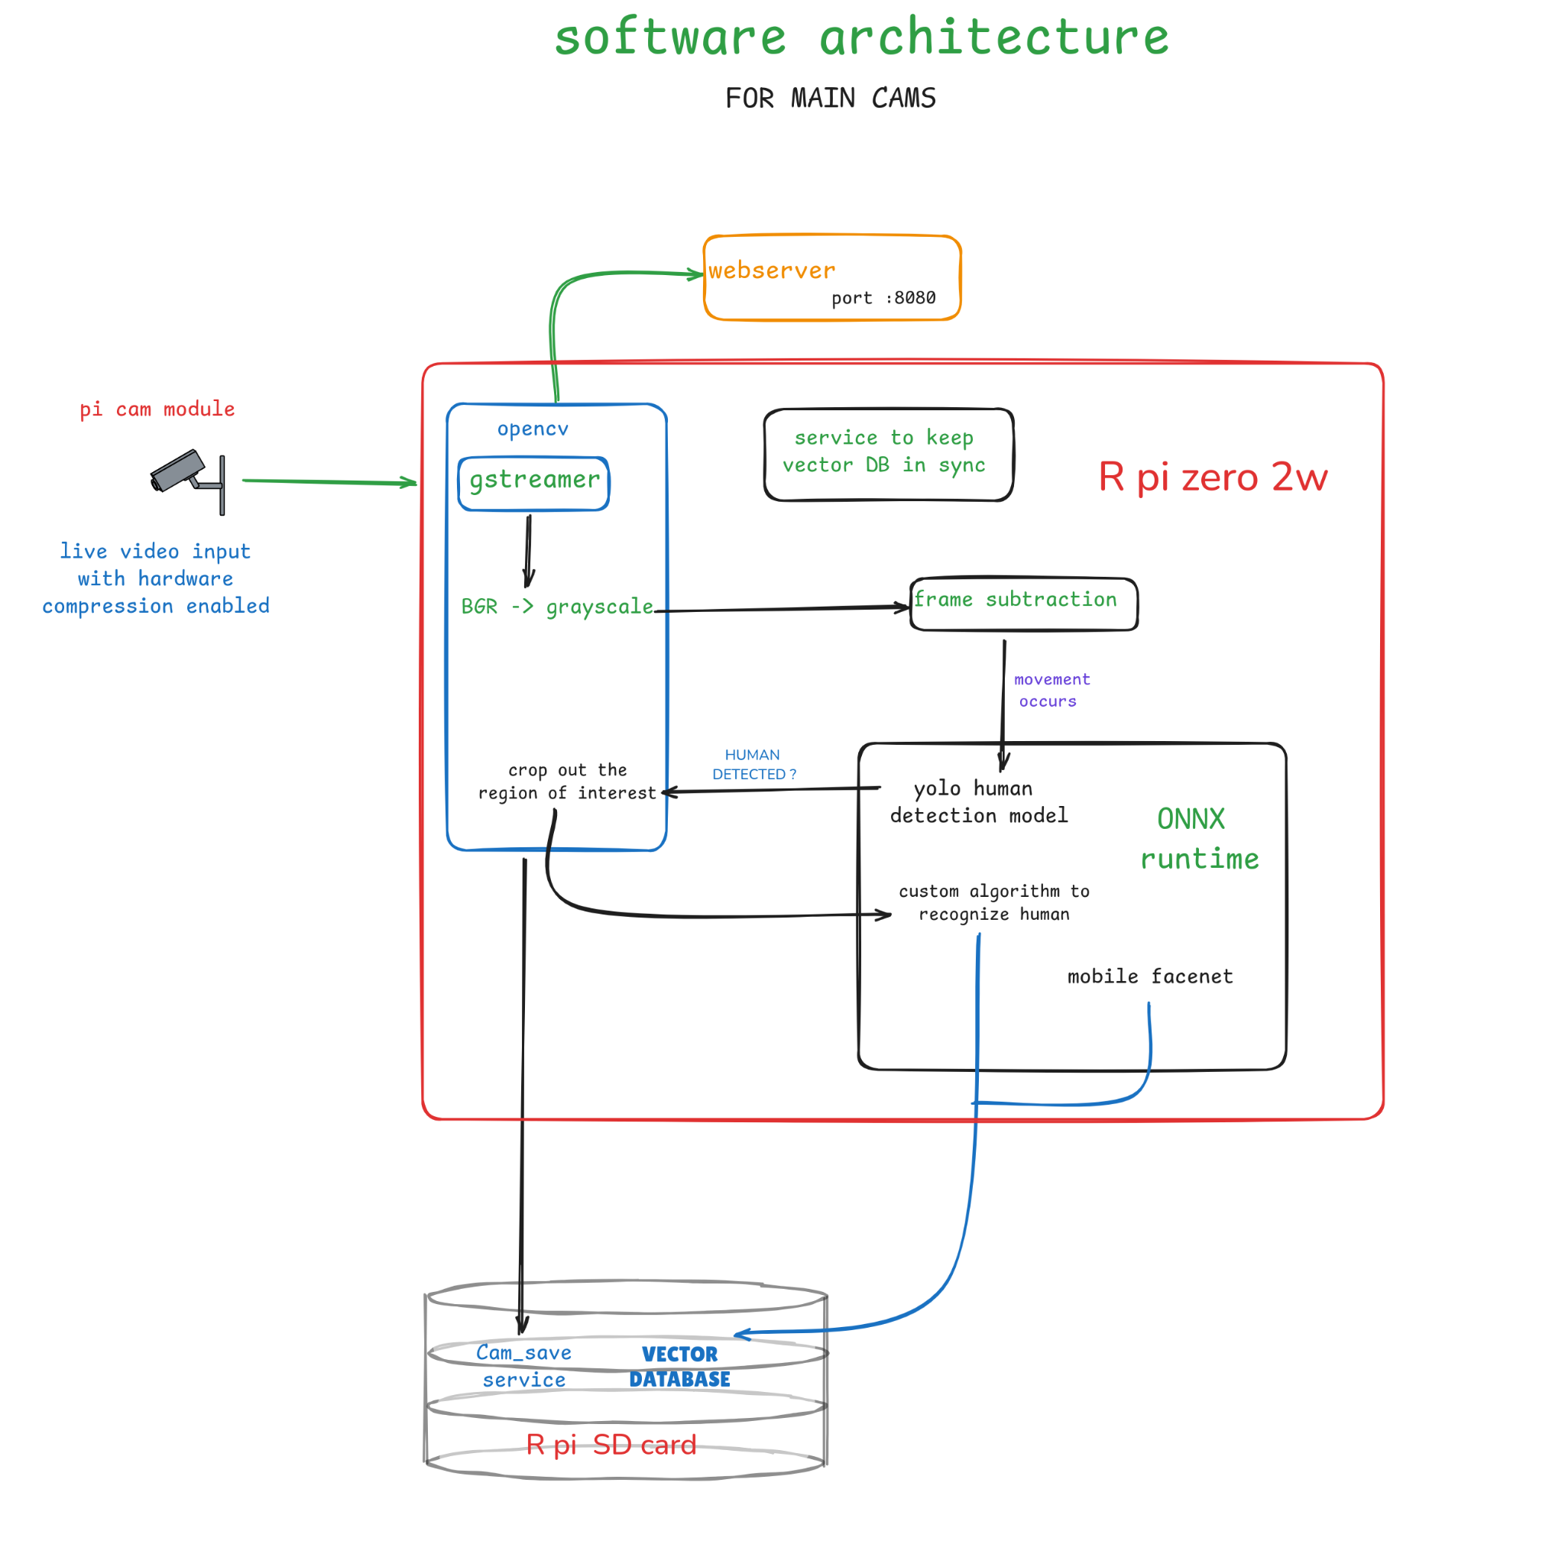
Efficient AI-Driven Edge Surveillance using Edge Computing
SOFTWARE ARCHITECTURE

Slide 11
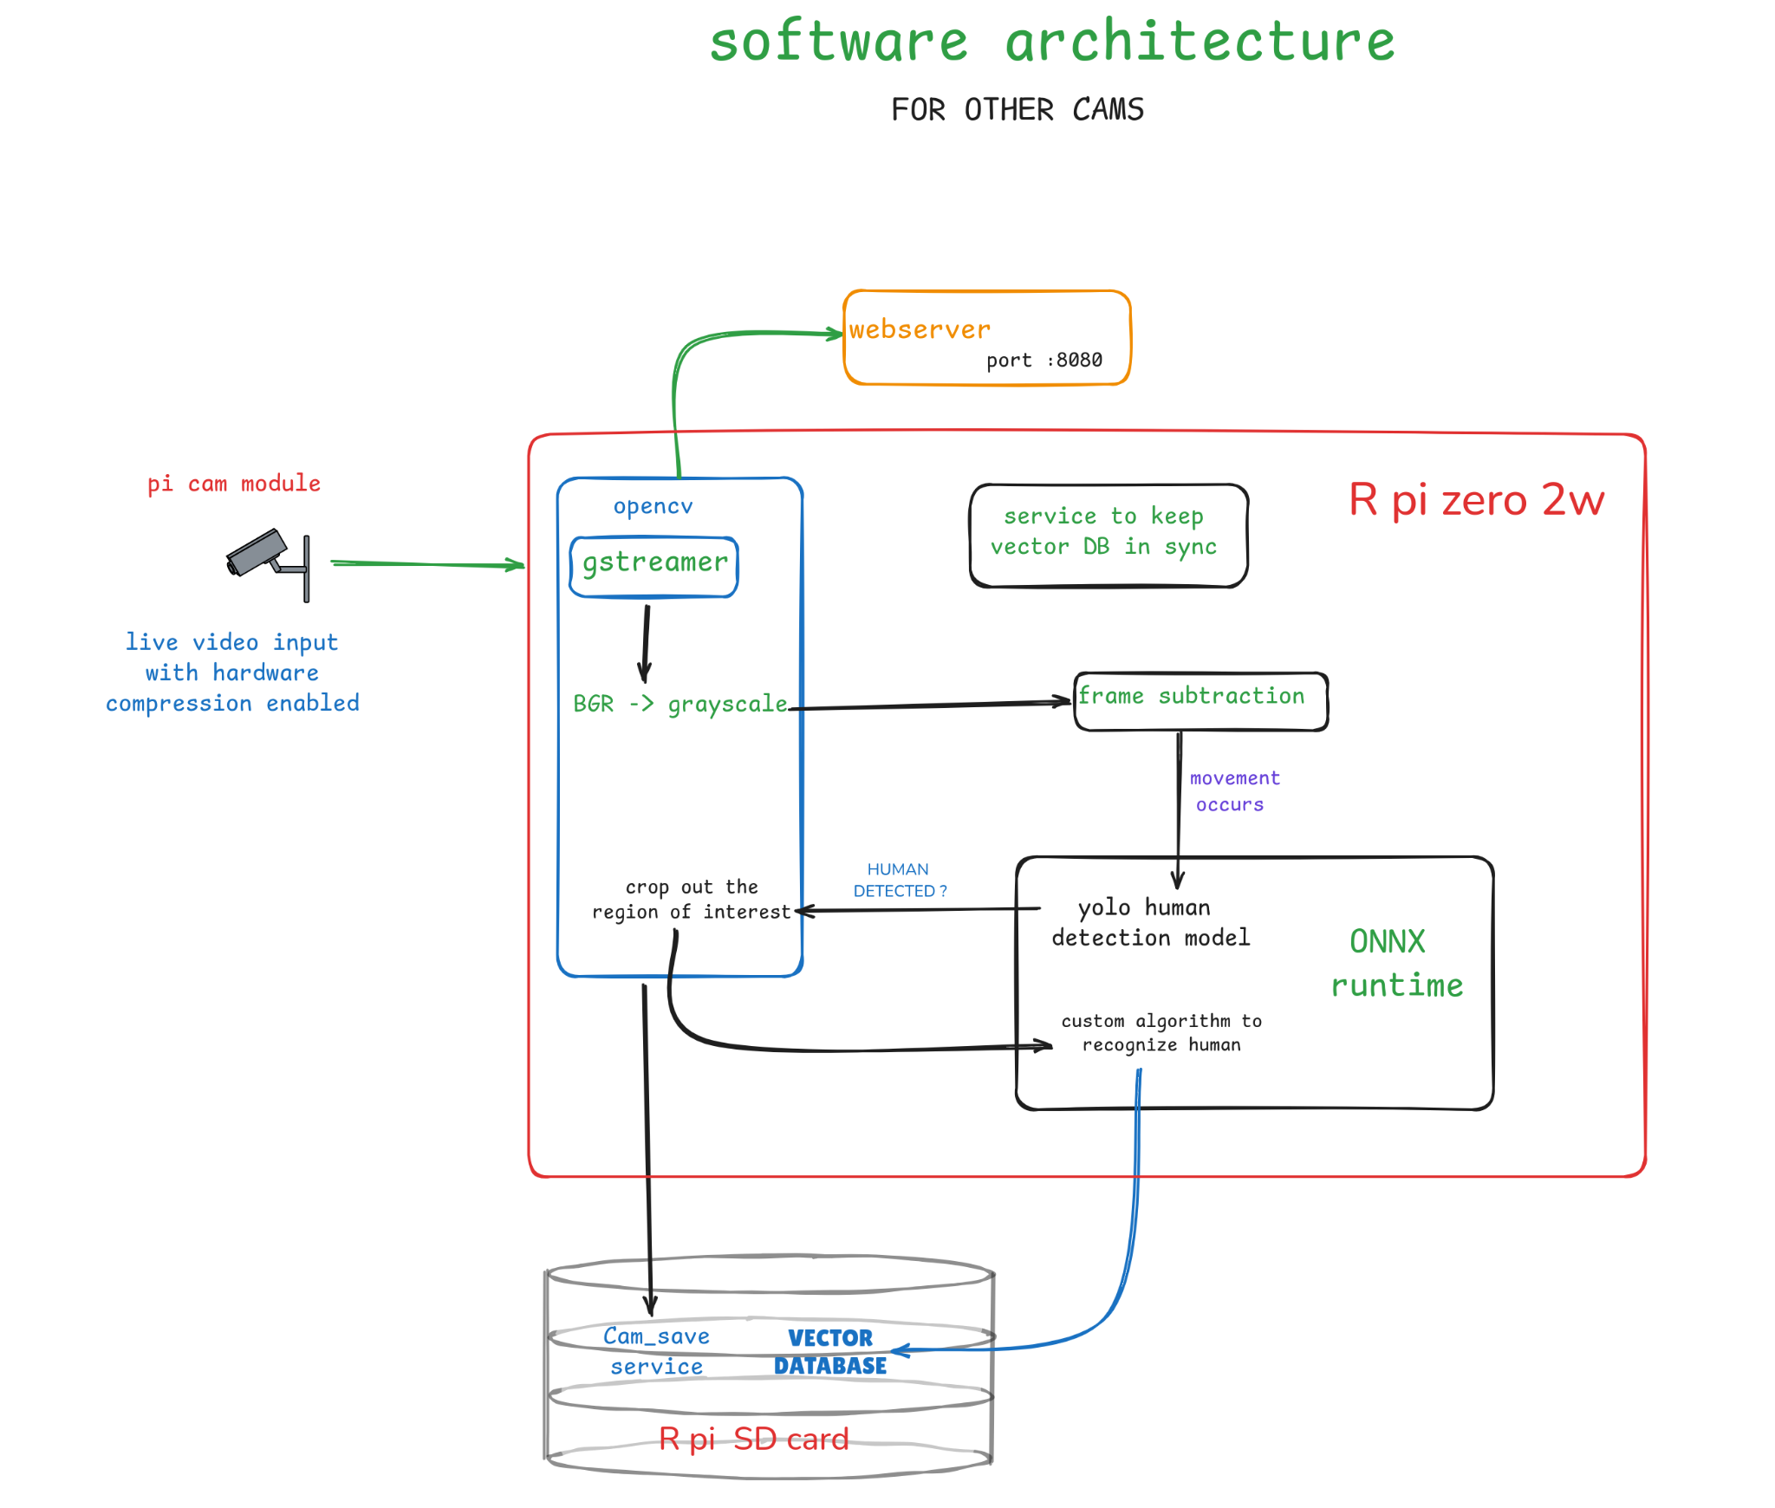
Efficient AI-Driven Edge Surveillance using Edge Computing
SOFTWARE ARCHITECTURE

Slide 12
Efficient AI-Driven Edge Surveillance using Edge Computing
Software architecture
We start by running a webserver on each of our raspberry pi. this web server is capable of streaming live feed from the camera.
Then we add a feature to take stream from another camera and still stay on the web page hosted from webserver your camera is on.
On the input video there is already hardware based compression happening to jpeg format. we take the same input video and run frame subtraction to check for movement and then yolo human detection.
If it the main camera we run facenet to check his identity and then send it to other servers. we resize the bounding box got from human detection and then send it to another custom algorithm to recognize humans.
Finally we use some vector database to log stuff.
Later, on demand we can scan through these logs to know which person was present in front of which camera at what time and then show this on the same webpage.

Slide 13
Efficient AI-Driven Edge Surveillance using Edge Computing
Design Constraints, Assumptions & Dependencies
We believe in using the following in phases for the System design of our project:
Phase 1:
4 X laptops with webcams
Phase 2:
4 X (Raspberry Pi 3A+ / Raspberry Pi zero)
4 X (Micro SD cards)
4 X (cis cam) (3-5 mp)

Slide 14
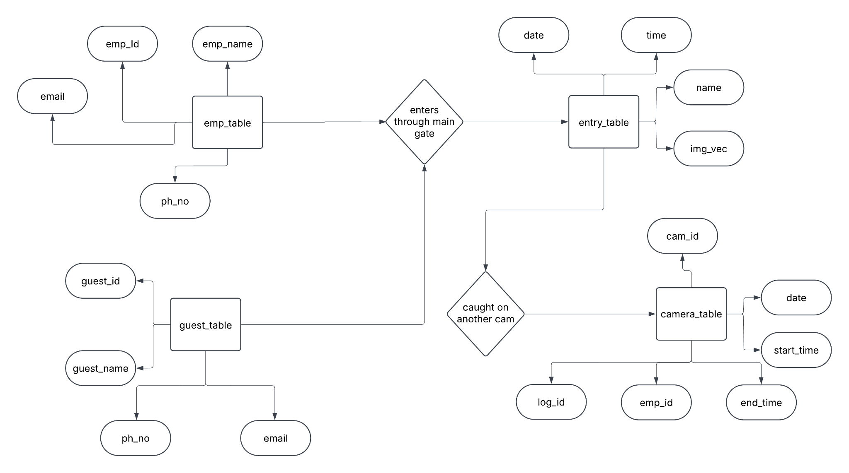
Efficient AI-Driven Edge Surveillance using Edge Computing
Design Description

Slide 15
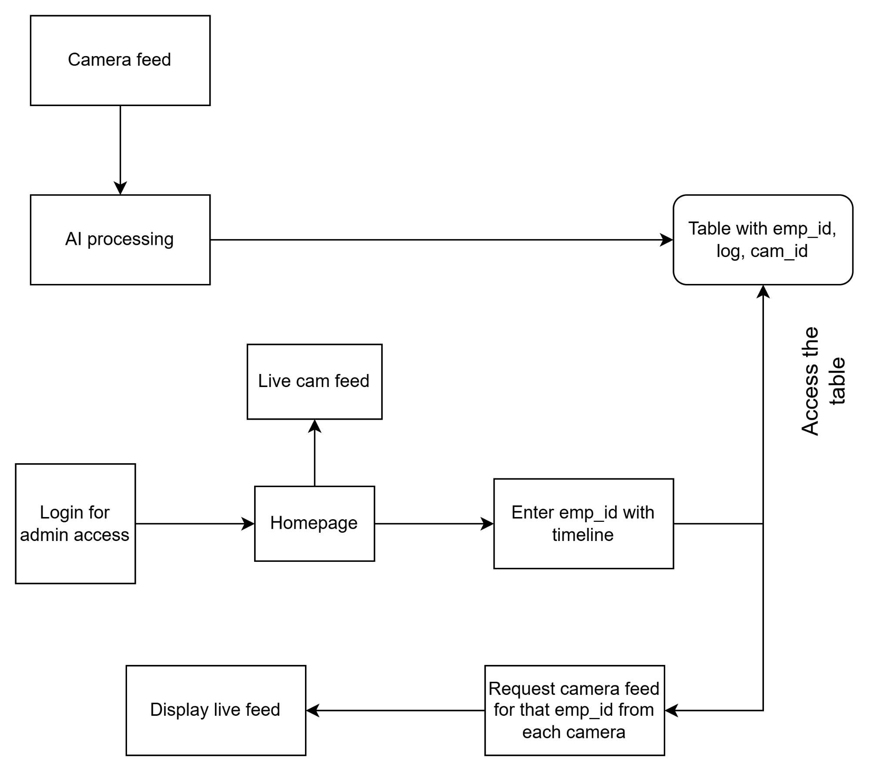
Efficient AI-Driven Edge Surveillance using Edge Computing
Design Description

Slide 16
Efficient AI-Driven Edge Surveillance using Edge Computing
Datasets Exploration/ Datasets preprocessing
From the paper: We collected a 18294 image dataset automatically from popular Hollywood movies. The images were obtained by running a state-of-the-art person detector on every tenth frame of 30 movies. People detected with high confidence (roughly 20K candidates) were then sent to the crowdsourcing marketplace Amazon Mechanical Turk to obtain ground truth labeling. Each image was annotated by five Turkers for $0.01 each to label 10 upper body joints. The median-of-five labeling was taken in each image to be robust to outlier annotation. Finally, images were rejected manually by us if the person was occluded or severely non-frontal. We set aside 20% (1016 images) of the data for testing.
Dataset link: https://paperswithcode.com/dataset/flic

Slide 17
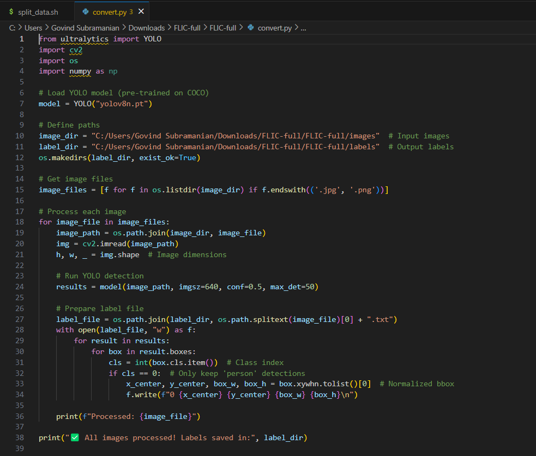
Efficient AI-Driven Edge Surveillance using Edge Computing
Datasets Exploration/ Datasets preprocessing

Slide 18
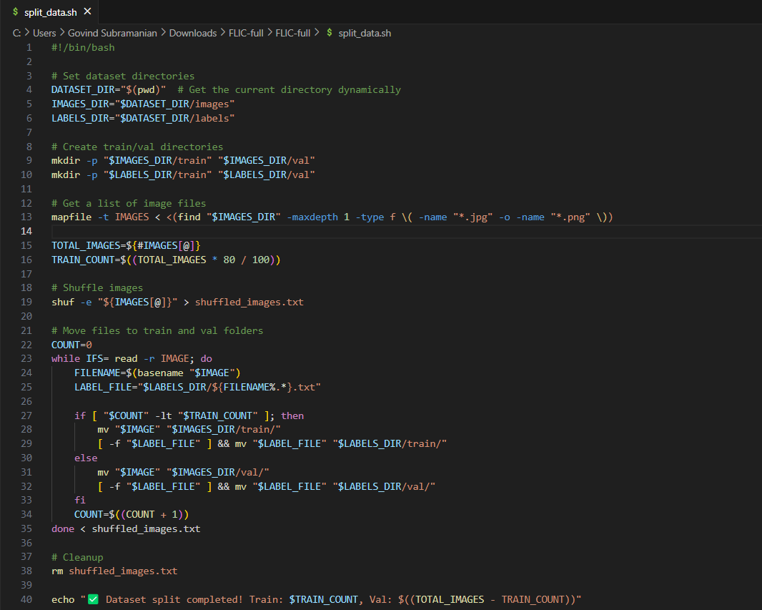
Efficient AI-Driven Edge Surveillance using Edge Computing
Datasets Exploration/ Datasets preprocessing

Slide 19
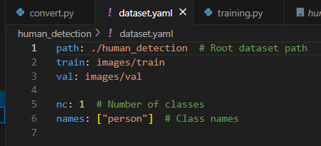
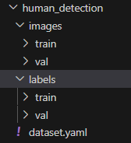
Efficient AI-Driven Edge Surveillance using Edge Computing
Datasets Exploration/ Datasets preprocessing

Slide 20
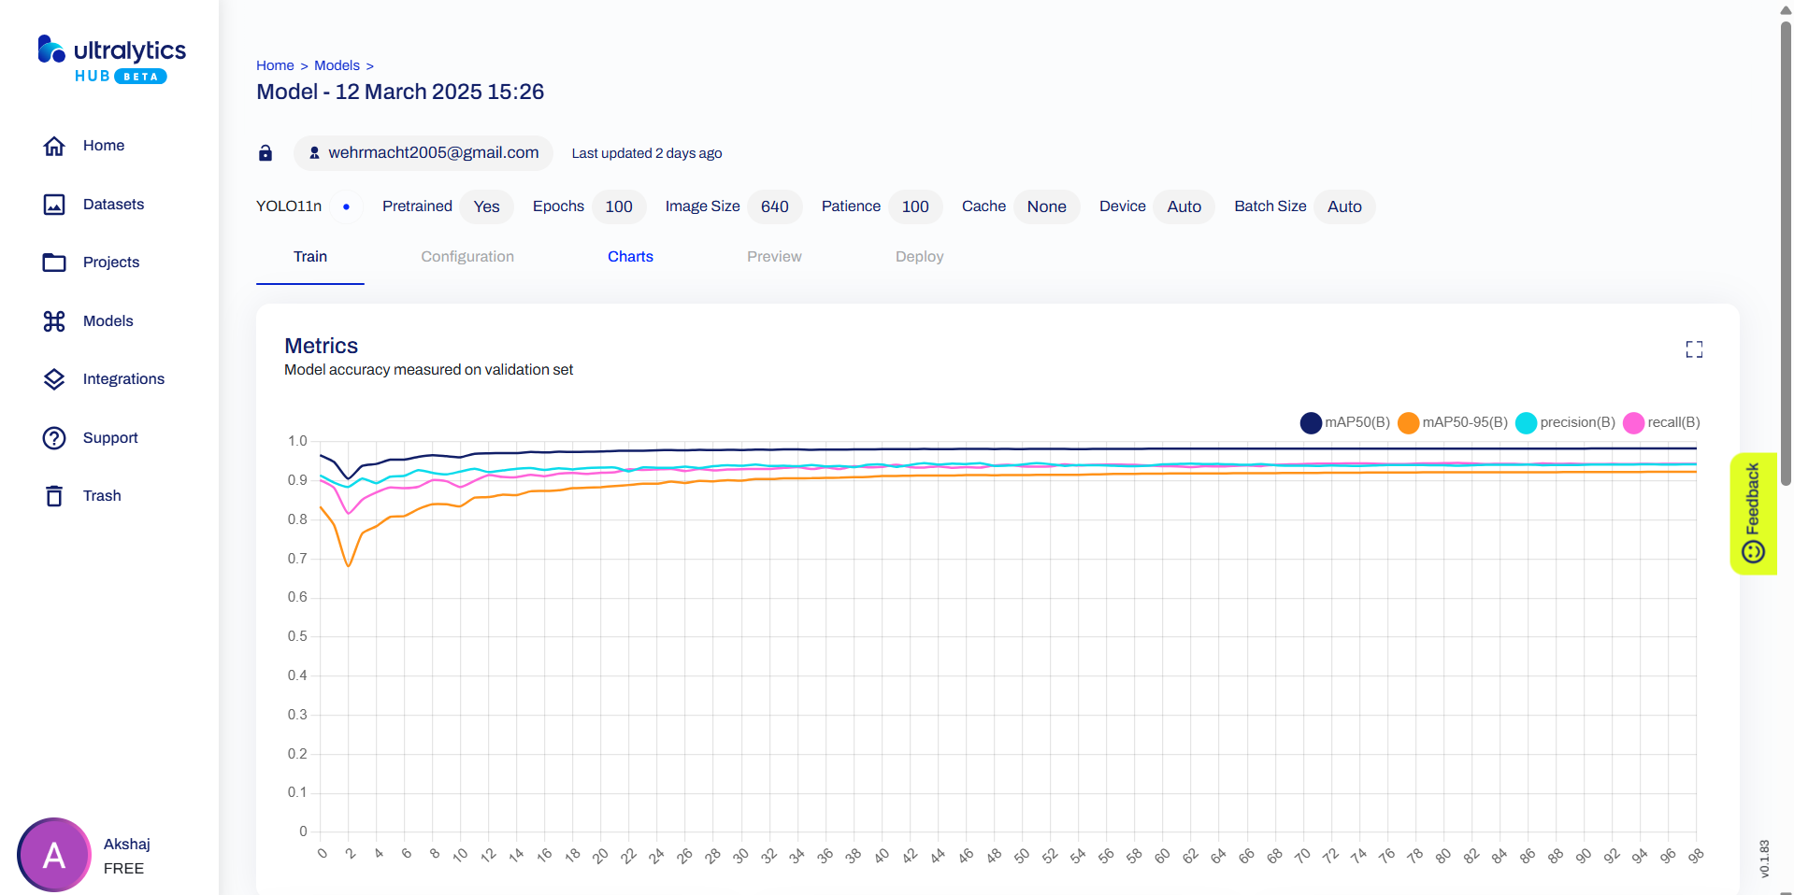
Efficient AI-Driven Edge Surveillance using Edge Computing
Base Model Implementation

Slide 21
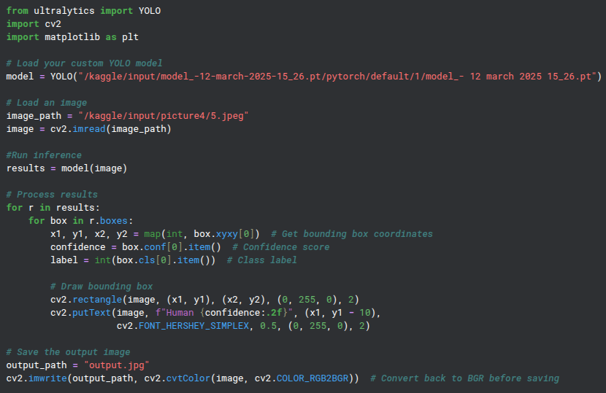
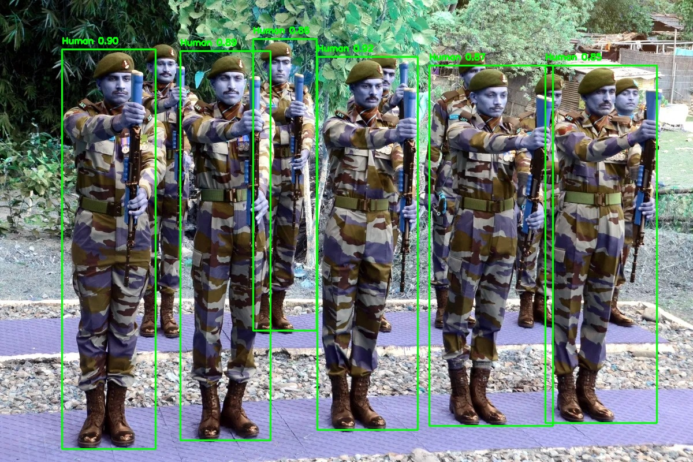
Efficient AI-Driven Edge Surveillance using Edge Computing
Base Model Implementation

Slide 22
Efficient AI-Driven Edge Surveillance using Edge Computing
Project Progress Plan for Phase 3 and Phase 4
We have started testing out on raspberry pi and had some amount of success on that. We believe the current available platform should be good enough for the required compute. If there is a case where we require more, we can switch to “orange pi zero” or “banana pi zero” .

Slide 23
Efficient AI-Driven Edge Surveillance using Edge Computing
References
1. Á. Carro-Lagoa, V. Barral, M. González-López, C. J. Escudero, and L. Castedo, "CITIC Research Center & Department of Computer Engineering, University of A Coruña, 15071, A Coruña, Spain," received Mar. 8, 2023, revised Jul. 26, 2023, accepted Sept. 8, 2023, available online Sept. 12, 2023, version of record Sept. 18, 2023
2.Y. Martínez-Díaz, H. Méndez-Vázquez, L. S. Luevano, L. Chang and M. Gonzalez Mendoza, "Lightweight Low-Resolution Face Recognition for Surveillance Applications," 2020 25th International Conference on Pattern Recognition (ICPR), Milan, Italy, 2021
3. P. Ramya, R. Rajeshwari, “A Modified frame difference method using correlation coefficient for background subtraction”, 6th International Conference On Advances In Computing & Communications, ICACC 2016, 6-8 September 2016, Cochin, India.
4. Jianguo Wang, Xiaomeng Yi, Rentong Guo, Hai Jin, Peng Xu, Shengjun Li, Xiangyu Wang, Xiangzhou Guo, Chengming Li, Xiaohai Xu, Kun Yu, Yuxing Yuan, Yinghao Zou, Jiquan Long, Yudong Cai, Zhenxiang Li, Zhifeng Zhang, Yihua Mo, Jun Gu, Ruiyi Jiang, Yi Wei, Charles Xie. 2021. Milvus: A Purpose Built Vector Data Management System. In Proceedings of the 2021 International Conference on Management of Data (SIGMOD ’21), June 20–25, 2021, Virtual Event, China. ACM, New York, NY, USA, 14 pages. https: //doi.org/10.1145/3448016.3457550 5.Chen, Sheng & Liu, Yang & Gao, Xiang & Han, Zhen. (2018). MobileFaceNets: Efficient CNNs for Accurate Real-Time Face Verification on Mobile Devices. 10.48550/arXiv.1804.07573.

Slide 24
Thank You

